Slide 1
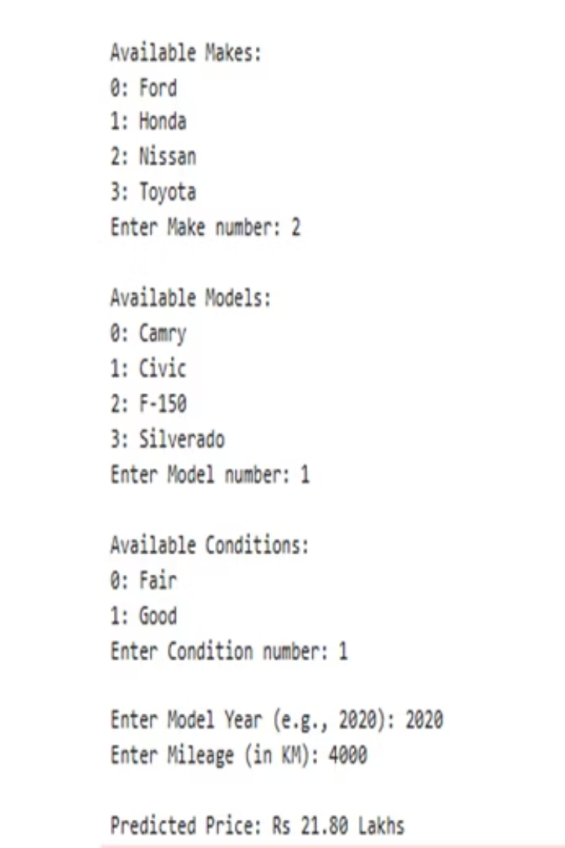
Car Price Prediction Using Regression
by Abdullah Azhar
A machine learning project leveraging regression to forecast used car prices. This presentation outlines the methodology, tools, and results of predicting car values based on key vehicle features.

Slide 2
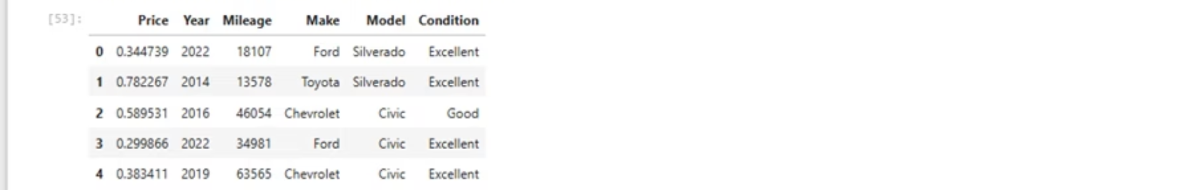




Understanding the Prediction Goal
Price
Target variable for prediction
Features
Key vehicle attributes
Regression
Modeling continuous outcomes
The core objective was to build a robust regression model. It predicts used car prices based on a comprehensive set of features. This approach allows for continuous value prediction, unlike classification.

Slide 3
Key Features Utilized
Vehicle Details
Powertrain
Brand and Model
Fuel Type
Manufacturing Year
Transmission Type
Mileage
Engine Size (L)
Extracted crucial features to drive prediction accuracy. Attributes like brand, model, and year define vehicle identity. Mechanical specifications, including fuel type and engine size, significantly influence market value.

Slide 4




Data Preprocessing Techniques
Label Encoding
Categorical to numerical conversion
One-Hot Encoding
Binary vectors for nominal data
Feature Scaling
Standardizing numerical features
Applied a sequence of robust preprocessing steps. Label encoding handled ordinal categories efficiently. One-hot encoding managed nominal features to avoid bias. Feature scaling normalized numerical data for model stability.

Slide 5

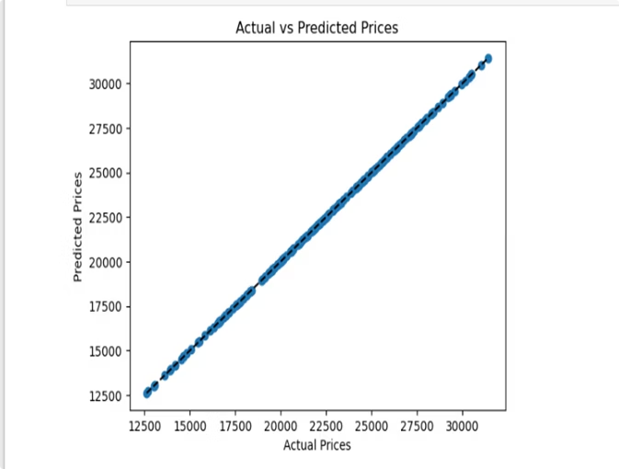
Linear Regression Model
Simplicity
Efficiency
Easy to interpret and implement
Computationally light for large datasets
Baseline Performance
Strong starting point for complex problems
Chose Linear Regression for its interpretability and efficiency. It provides a clear relationship between features and price. This model serves as a strong baseline for performance.

Slide 6
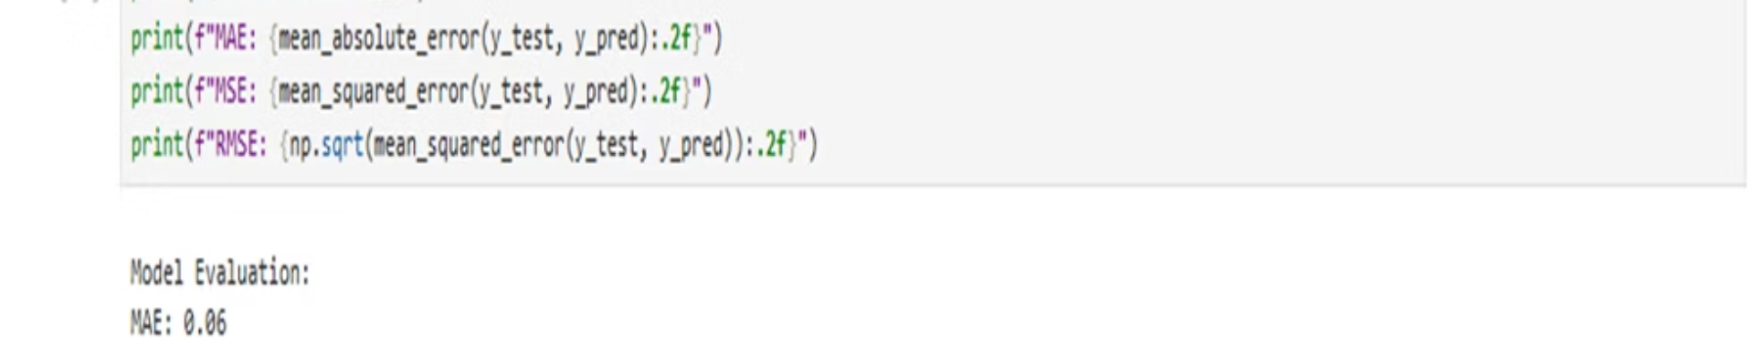
Model Evaluation Metrics
MAE : Mean Absolute Error
RMSE: Average prediction error
MSE: Squared average prediction error
Evaluated model performance using standard regression metrics. R² indicates the proportion of variance captured. RMSE and MSE quantify the magnitude of prediction errors.

Slide 7
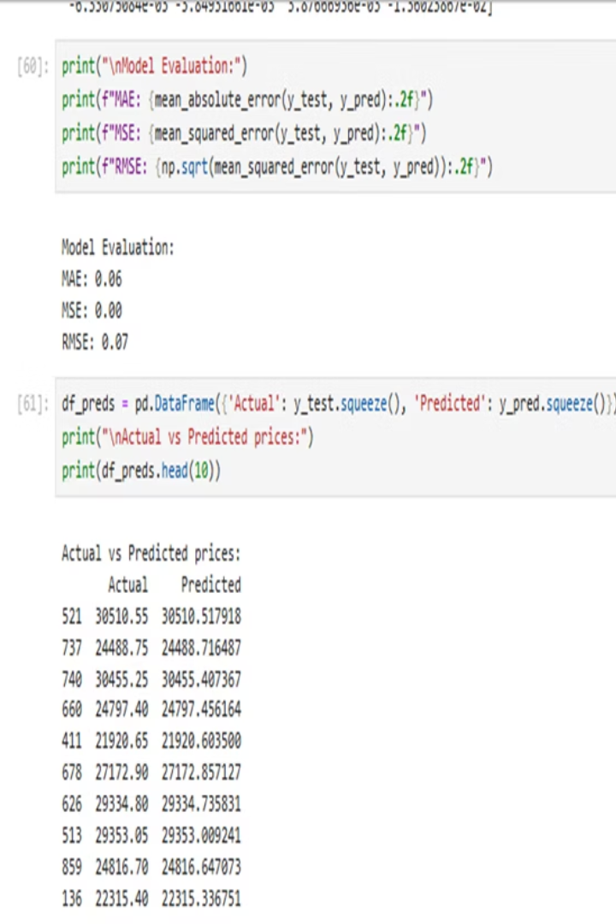
Performance Results
0.88
0.07
RMSE
R2 Score
High explanatory power
Average error
0.00
MSE
MSE : 141,267,970,507.58
Squared error magnitude
Indicating good fit. RMSE of approximately 376,000 indicates typical prediction error. MSE value further quantifies the model's accuracy.

Slide 8
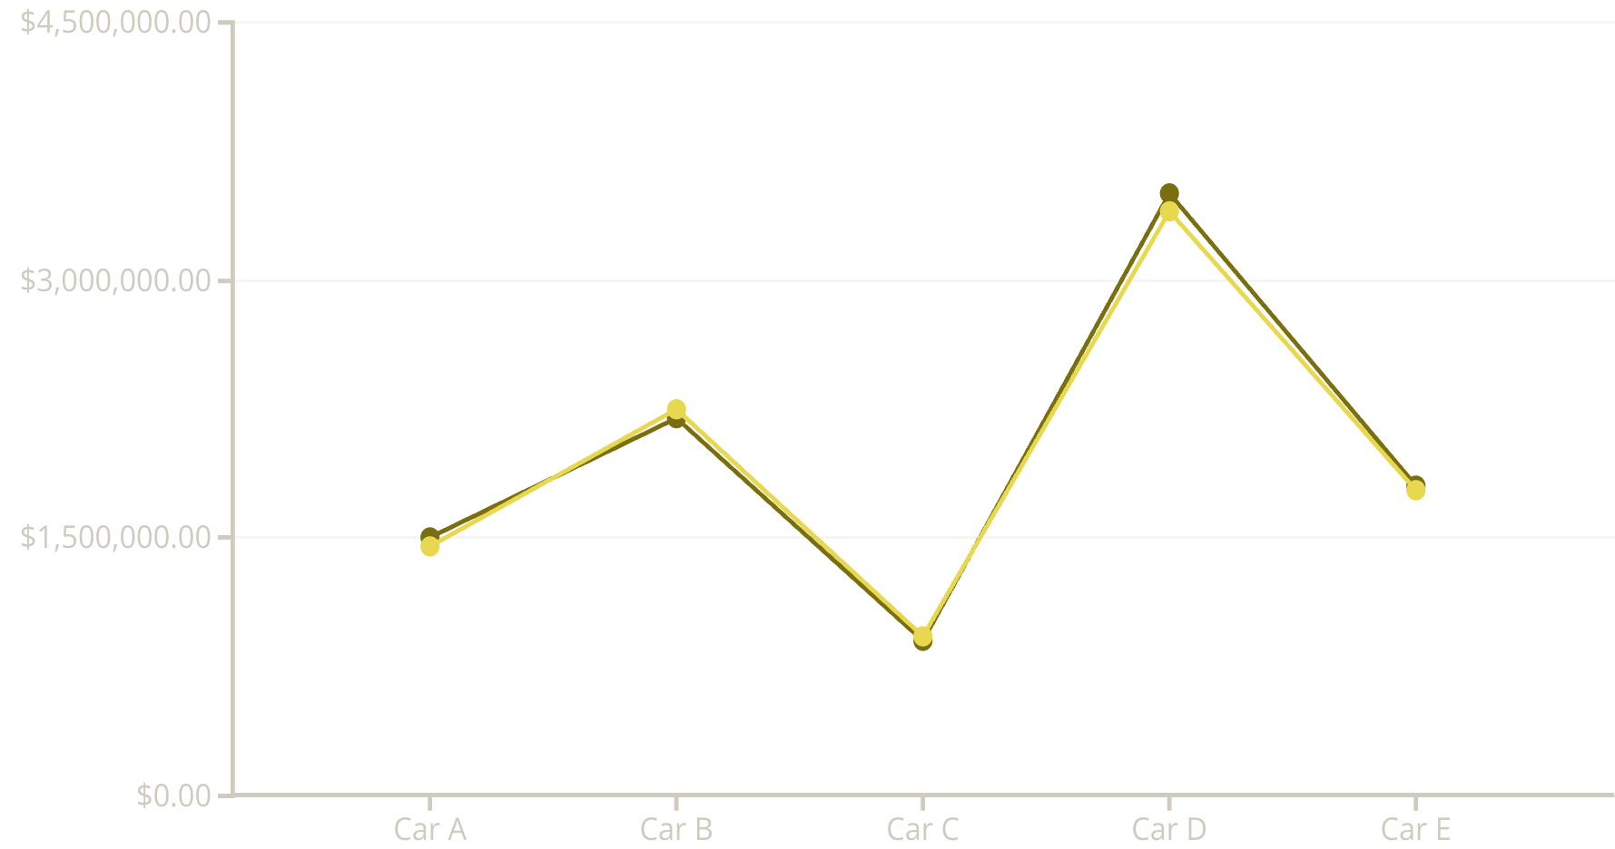
Actual vs. Predicted Prices
Actual Price
Predicted Price
The line chart illustrates the close alignment between actual and predicted car prices. This visual confirms the model's ability to estimate values accurately. Minor discrepancies indicate areas for potential future refinement.

Slide 9
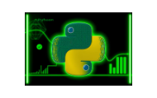



Tools and Libraries Used
Leveraged Python for its versatility in data science. Pandas for efficient data manipulation and analysis. Scikit-learn for robust machine learning model implementation. Matplotlib for creating insightful visualizations of results.

Slide 10

Key Takeaways and Next Steps
1
Accurate Predictions
2
Feature Impact
Model achieved high R² for car price forecasting
Brand, mileage, engine size are key drivers
3
Future Enhancements
Explore advanced models or feature engineering
The regression model demonstrated strong predictive capabilities. Further work can explore deep learning or ensemble methods. Integrating external data, like market trends, could enhance accuracy.

